Slide 1
Guaranteed In Big Tech?
Is Employee Satisfaction
Team 2: Abla Elsergany, Cristian Salazar,
Jordy Salguero, Seeh Sohn

Slide 2
Agenda
1- Motivation and Questions
2- Data cleanup
3- Data Visualization
4- Word Cloud Visualization
5- Statistical Testing
6- Post Mortem
7- Q&A

Slide 3
1- Motivation And Questions

Slide 4
Which companies are highest in general employee satisfaction vs data analyst satisfaction?
Notes:
That is the core of our study. However we were not able to answer that in relation to data analytics because we did not have that kind of data.
We were able though to visualize which companies are the achieving best reviews from their employees

Slide 5
2. How the company ratings have changed over time?
Notes:
This question gives us perspective into the company’s policies and how likely the company will treat its employees fairly or not depending on their revenue.

Slide 6
3. What is the correlation between position and advice to management?
Notes:
We were able to make a pie chart for this topic.
We thought at the beginning that the more the employees are willing to give advice to management, the better it is for the company, because it says that the company policy is not oppressive. However we were surprised to find out that that is not the case, as we will show you later when this section comes.

Slide 7
2- Data Cleanup

Slide 8
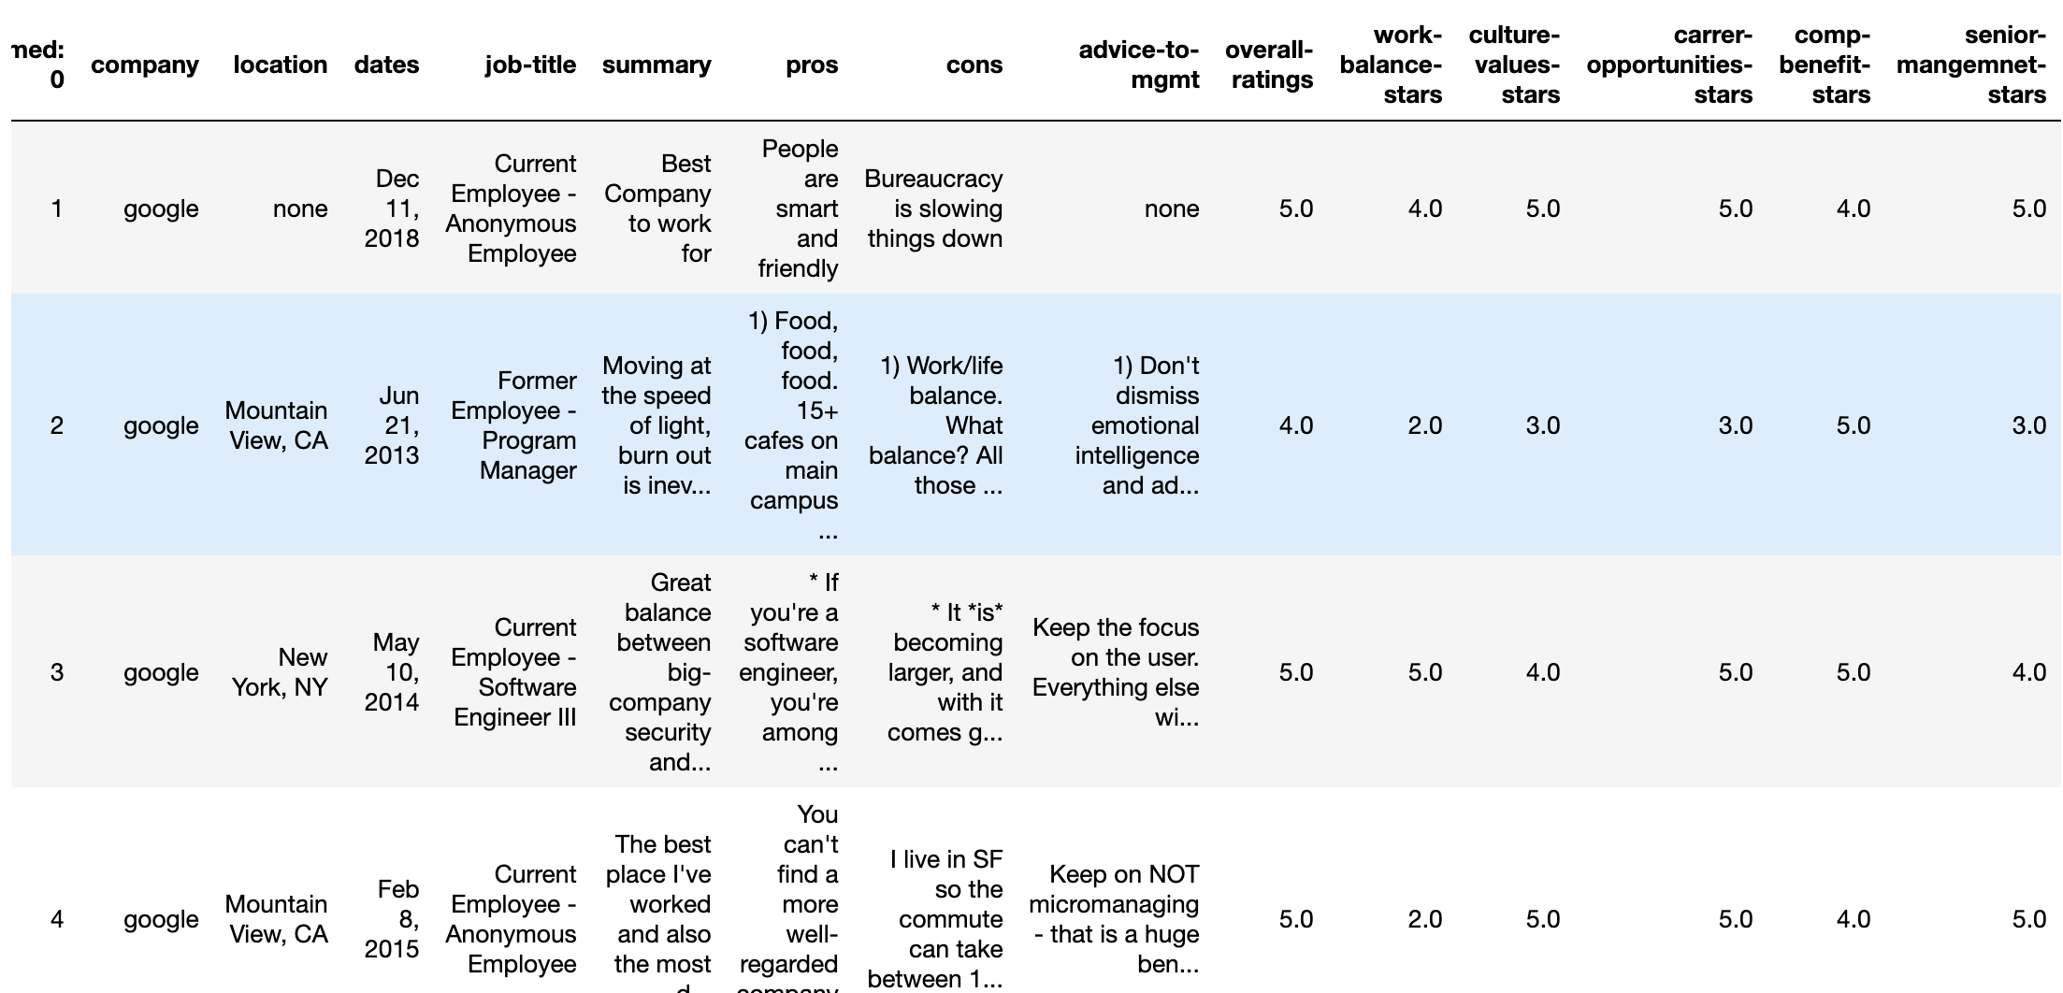
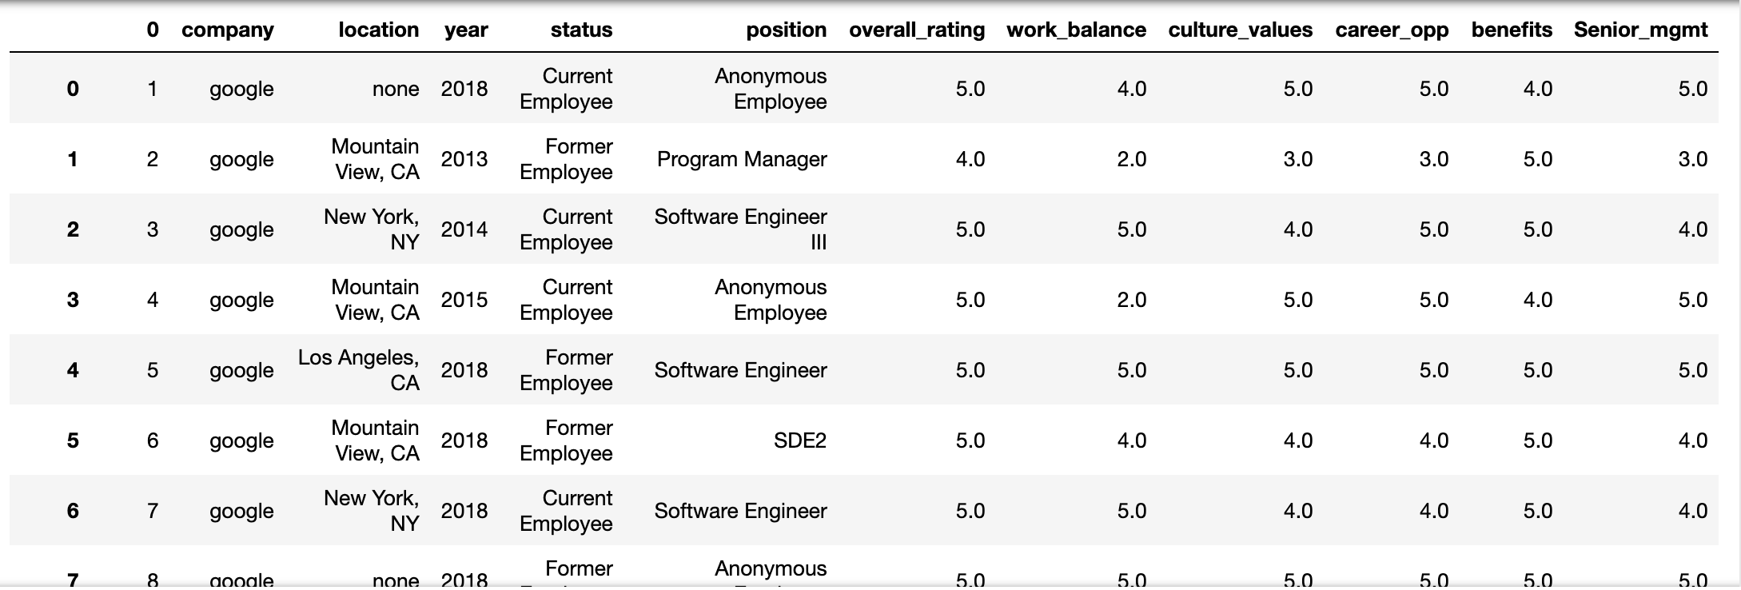
Original DataFrame:
Cleaned DataFrame:

Slide 9
3- Data Visualization

Slide 10
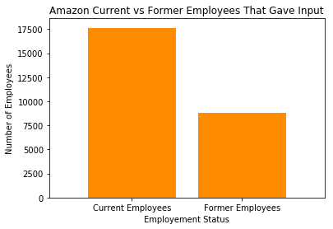
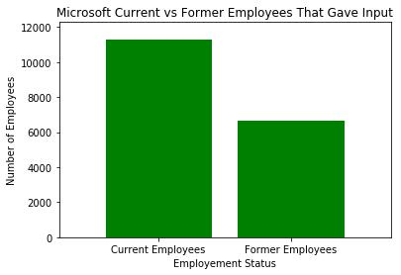
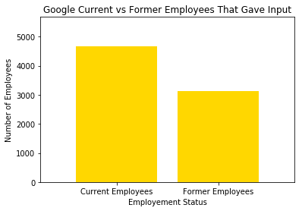
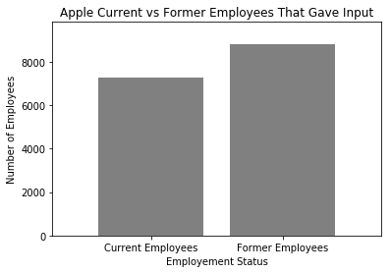
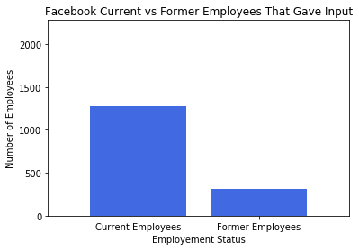
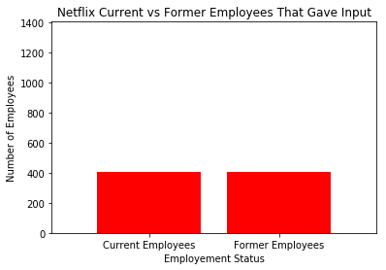
Employment Statuses
v
Notes:
The amount of current and former employees that did the glassdoor survey

Slide 11
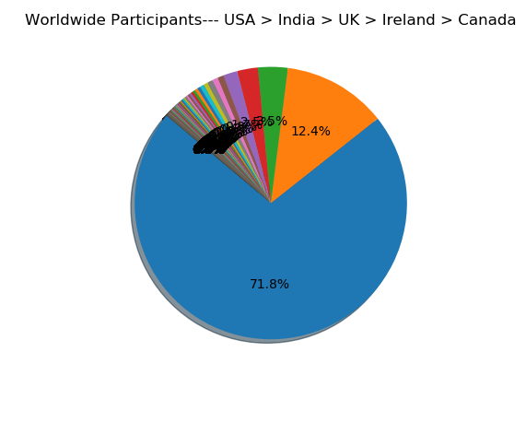
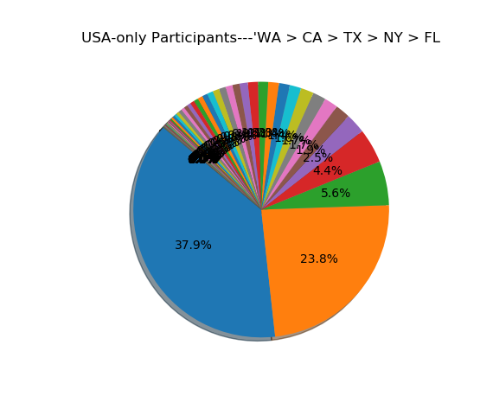
Demographic Distribution of Participants:

Slide 12
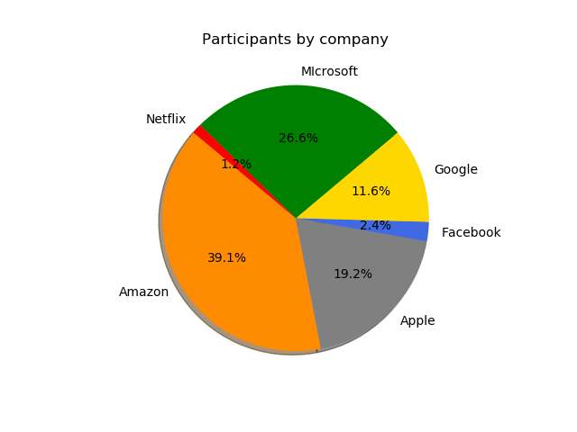
Distribution of Participants by Company

Slide 13
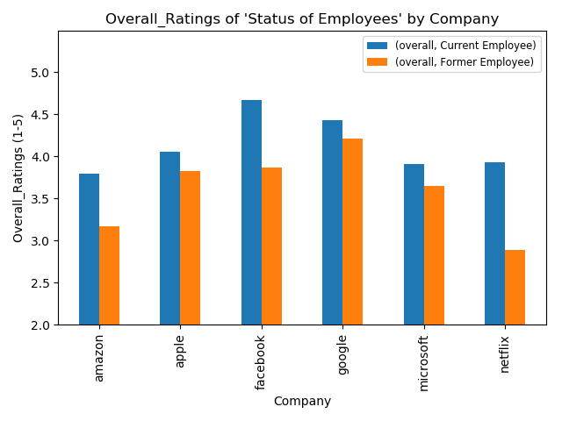
Distribution of Employee Status by Company

Slide 14
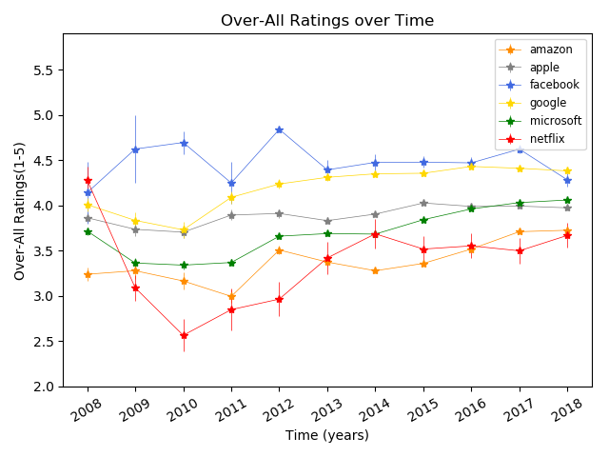
Overall Rating over Time

Slide 15
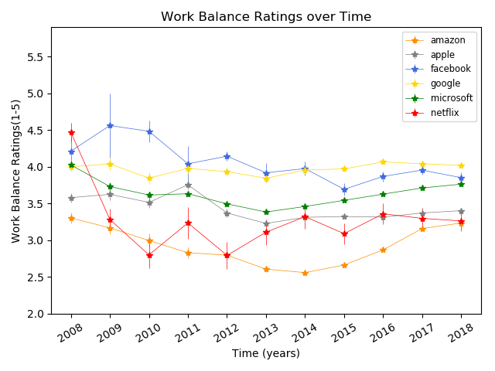
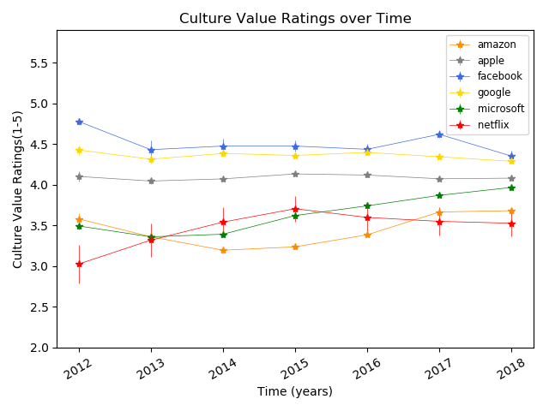
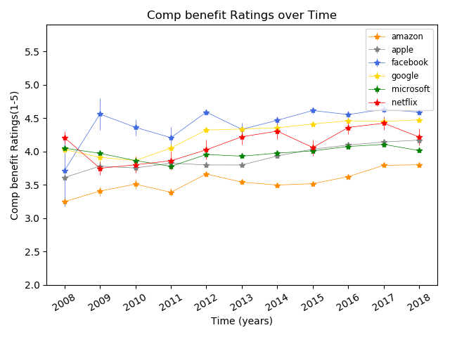
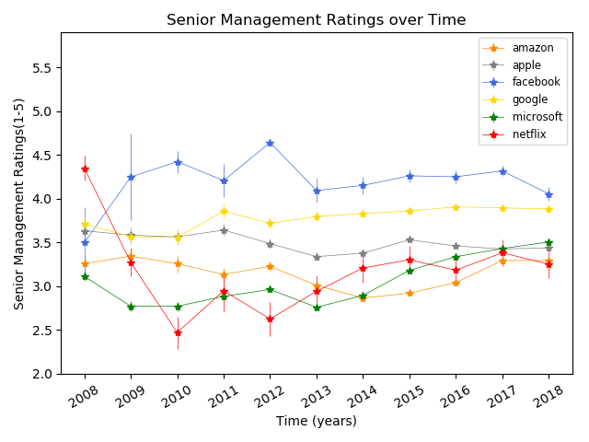
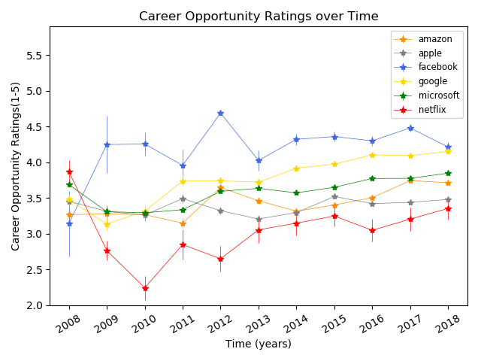
Ratings Timeline

Slide 16
Which employees give more advice to management?

Slide 17
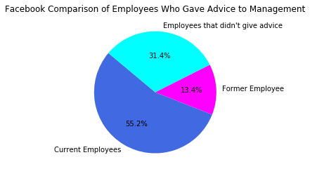
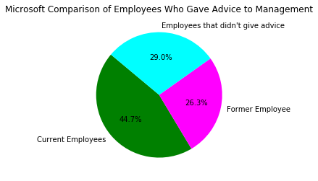
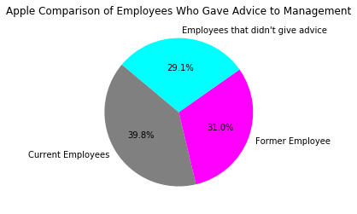
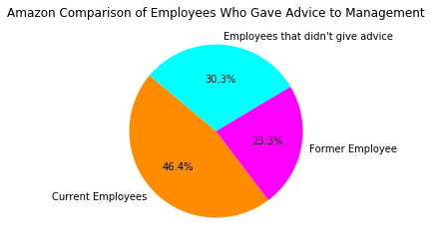
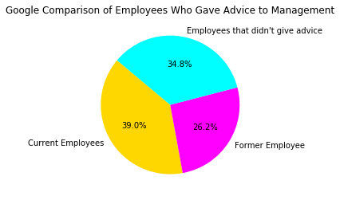
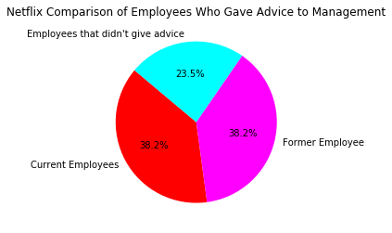
Employees Who Gave Advice to Management
Notes:
I wanted to see if more current or former employees gave advice to management.

Slide 18
4- Word Cloud

Slide 19
Word Cloud
“Tell me how you really feel...”
Notes:
We used a new library called Word Cloud to help us analyze two specific columns in our Database, Pro’s and Con’s. Our initial thought was to remove these columns because there were just employee opinions. In fact, the opinions ranged from a few words to a few sentences. Therefore, instead of removing these columns, we asked ourselves, so how do they really feel. Long behold, we used Word Cloud to give us a neat visual of the repeated words for each company.
We found that cons were very similar, including words such as Work Balance, Management, and Environment and the pros were Smart People, Good Pay, and Great Benefits. Interestingly, Google had a unique benefit (Free Food)!

Slide 20

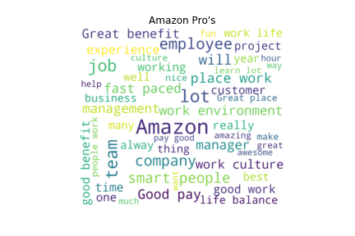
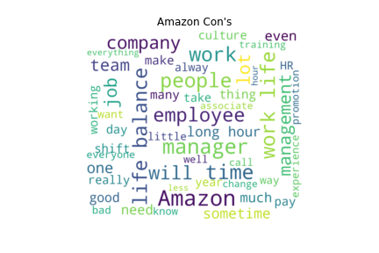
Pro’s : Good Pay, Team Environment, Smart People
Con’s : Life Balance, Long Hour’s, Management
Notes:
Pro Keywords = Good Pay, Team, Environment
Cons Keywords = Life Balance, Employee, Management, Work Life

Slide 21

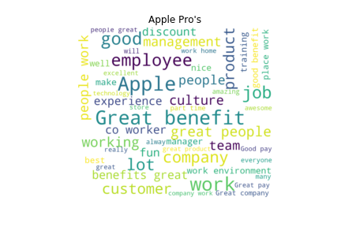
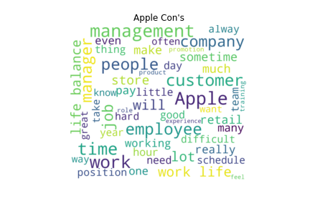
Pro’s : Benefits, Employee’s, Product
Con’s : Life Balance, Customer’s, Management
Notes:
Pro Keywords = Benefits, Employee, Product, Training
Cons Keywords = Management, Life Balance, Position, Work Life

Slide 22

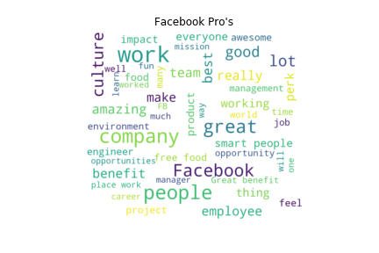
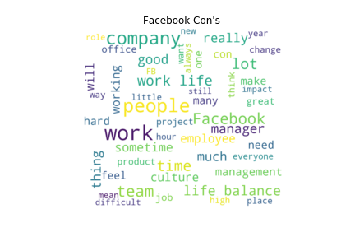
Pro’s : Culture, Smart People, Benefits
Con’s : Life Balance, Management, Time
Notes:
Pro Keywords = Culture, Smart People, People
Cons Keywords = Management, Work Life, Life Balance

Slide 23

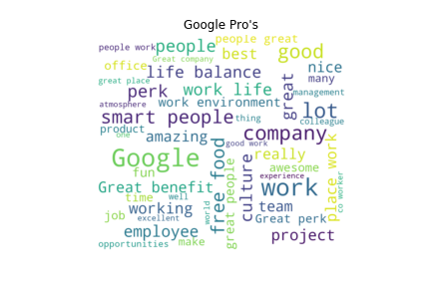
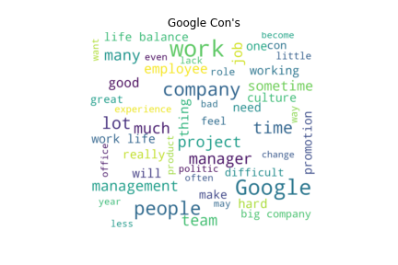
Pro’s : Life Balance, Free Food, Smart People
Con’s : Promotions, Life Balance, Management
Notes:
Pro Keywords = Free Food, Life Balance, Smart People
Cons Keywords = Promotion, Life Balance, Management

Slide 24

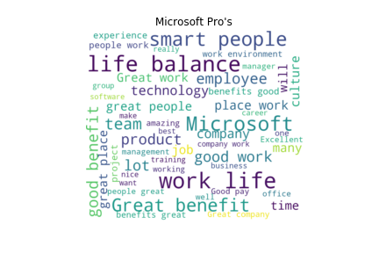
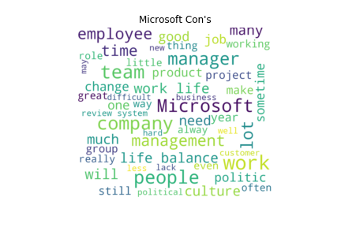
Pro’s : Life Balance, Great benefits, Smart People, Products
Con’s : Management, Culture, Political
Notes:
Pro Keywords = Life Balance, Smart People, Work Life
Cons Keywords = Management, People, Life Balance, Culture

Slide 25

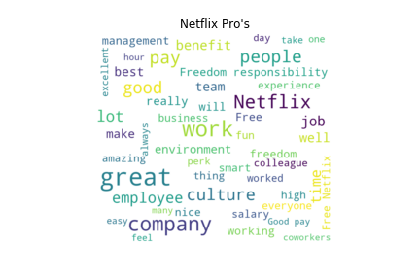
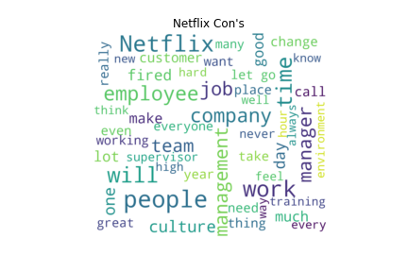
Pro’s : Culture, Freedom, Good Pay
Con’s : Management, Environment, Working in Teams
Notes:
Pro Keywords = Culture, Freedom, Good Pay
Cons Keywords = Management, Environment, Working in Teams

Slide 26
5- Statistical Testing

Slide 27
Statistical Testing:
Boxplots for the means
ANOVA
Pairwise Comparisons using Tukey Method
Notes:
For testing we took only a section of the data from 2014 to 2018, because when someone is searching for a job, they care most about how the company is doing in the past 3-5 years, and before that it becomes history.

Slide 28
1) Boxplots

Slide 29

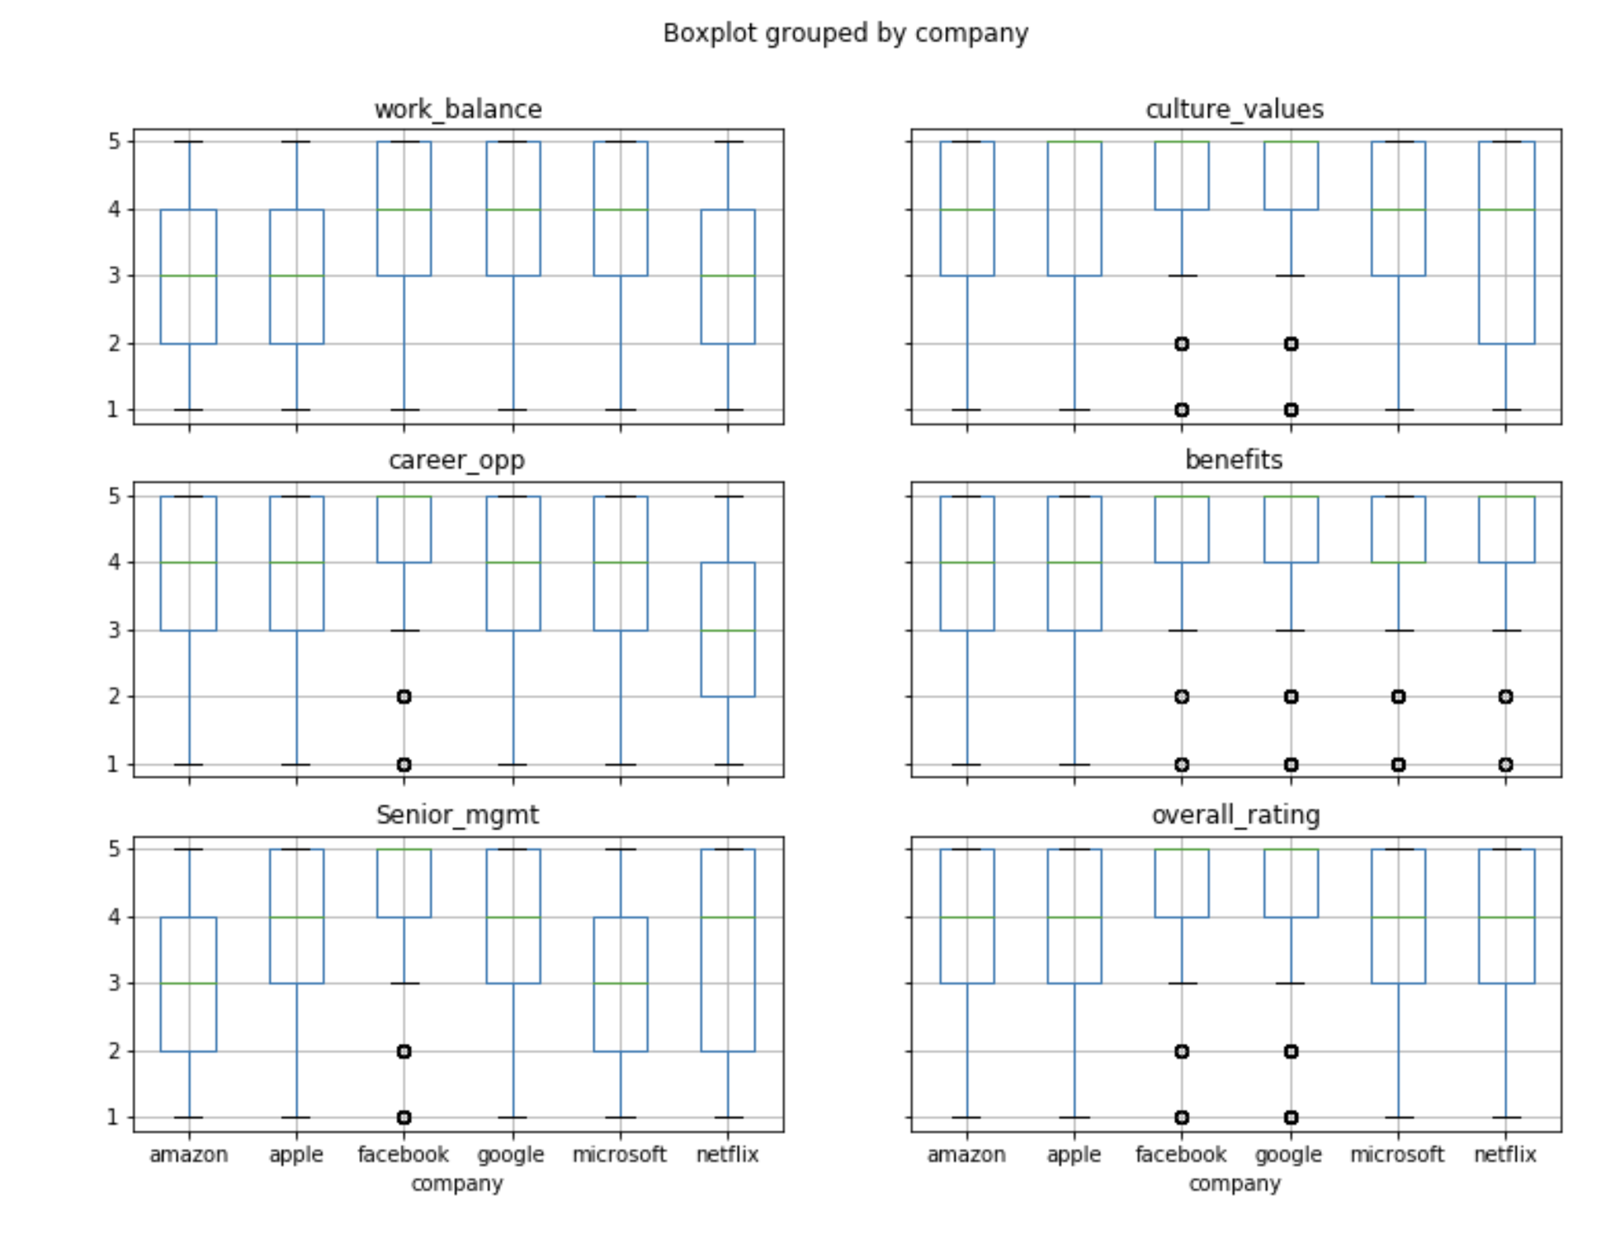
Comparing the companies’ Means for each review aspect
Notes:
Each boxplot represent one aspect of the reviews. We have six aspects:
Work balance, culture values, career opportunities, benefits, senior management, and overall rating
Each boxplot figure shows which companies excel in which review aspect.
Facebook and Google are excelling in all of the 6 aspects of the reviews, except for few outliers here and there.
Amazon clearly has some problems with career opportunities and senior management.
Apple ranges between 3 and 5 star reviews for almost all of the reviews. Which puts it in middle position
Microsoft is excelling in its Benefits to the employees, and we can attest to that by the fact that it gave for some time one year maternity and paternity leave to its employees. But then it realized that is difficult for the company so it compensated them with $20,000 beside 6 months paid leave in the occasion of becoming parents. However they are struggling a bit with senior management like Amazon.
Finally, we come to Netflix, its senior management reviews varies widely from 2 to 5 stars, which leaves us with little to say about that. It is clearly excelling though in its benefits to employees

Slide 30
2) ANOVA
Notes:
We did ANOVA testing for each aspect of the reviews comparing the means of the companies for that aspect. All the ANOVA testing led us to reject the Null Hypothesis that the means are equal. So we decided to go further and do pairwise comparisons.

Slide 31
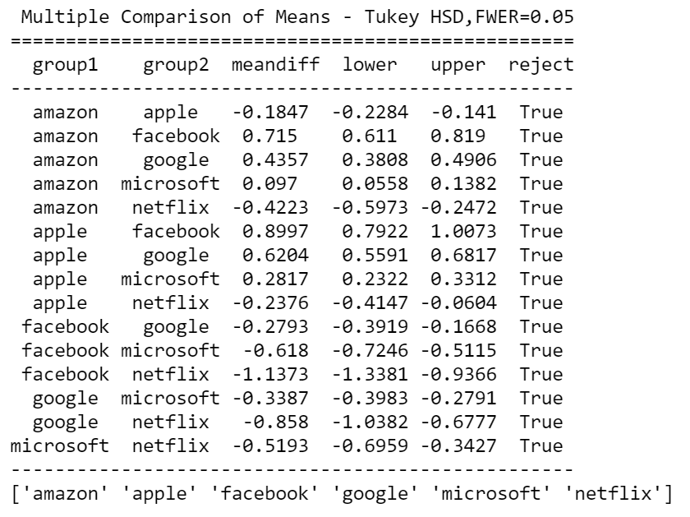
3) Pairwise Comparisons
Using Tukey Method to control for alpha
Notes:
We used here a new library called STATSMODEL. It has a function to run pairwise comparisons using Tukey’s formula. After doing that, we found out that all the companies are statistically different from each other in every single aspect except for a handful:
Netflix and Apple has no significant difference between them in terms of work balance.
Netflix-Amazon and Netflix-Microsoft have no significant difference between them in terms of culture values and senior management
Netflix-Amazon and Google-Facebook are statistically similar in the overall ratings

Slide 32
6- Post Mortem
Notes:
Talk about the heatmap

Slide 33
7- Questions

Slide 34
End
“So have you decided which company to join?”
Thank you!

